Slide 1
Joystick & Button Controlled Robot using nRF Module
MADE BY-
SUJAY ALASPURE
SIMRAN MESHRAM
GUIDED BY-
PROF M. W. NASIM

Slide 2
INTRODUCTION
We used the Arduino Uno board and an Radio frequency trans receiver.
The whole project is distributed in two parts
Transmitter:
It transmit signals in the air given by microcontroller board
Receiver:
It detects the signal coming out from transmitter and acts according to the signals.

Slide 3
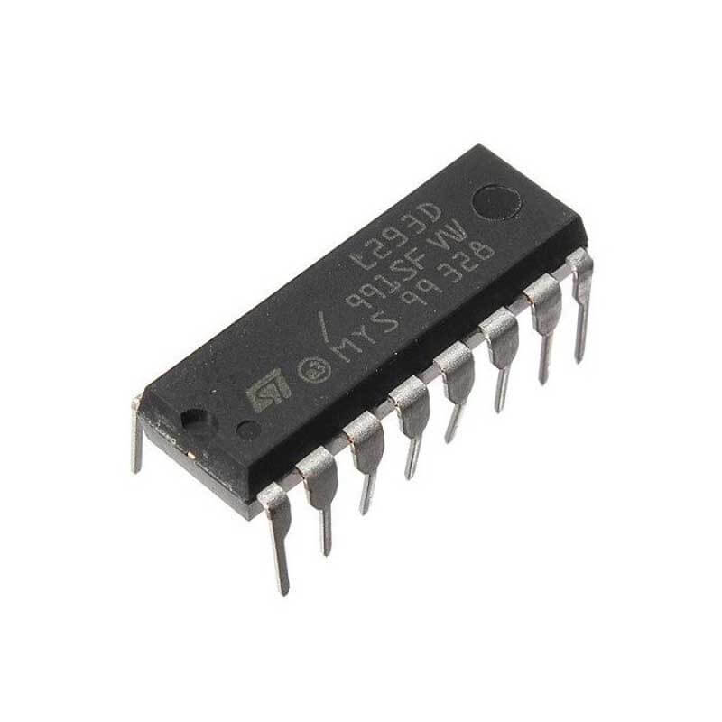
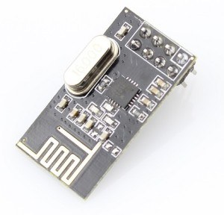
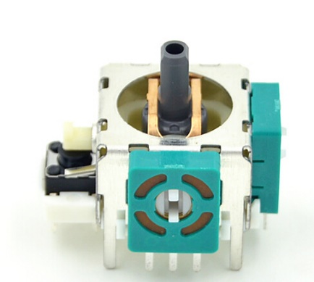
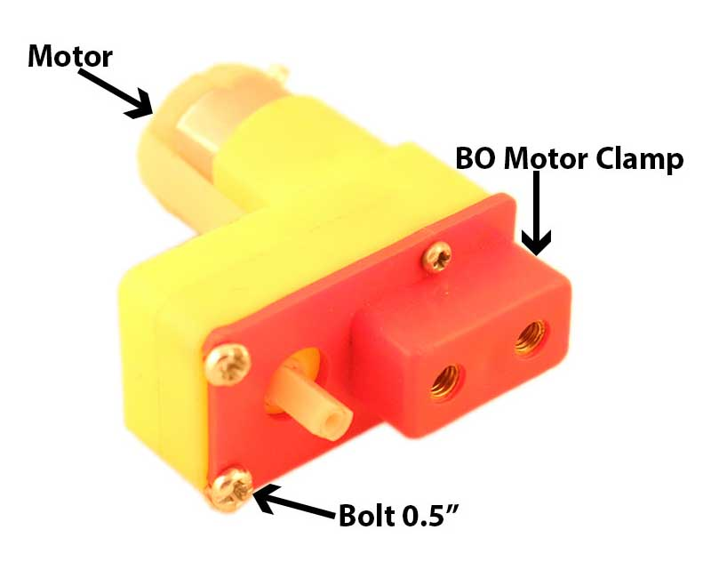
COMPONENTS USED
Transmitter
Receiver Bot
Arduino Nano
nRF 24L01 Module
Joystick
Toggle buttons
3.7v Battery
Arduino Uno
nRF 24L01 Module
DC motors
Bot chassis
Battery
Motor driver

Slide 4
COMPONENTS SPECIFICATIONS
nRF 24L01
Arduino Uno & Nano
2.4 GHz speed
  It can transfer data with 2MBps speed
100 mtr radius range and cab be increased
Low power consumption
6 data pipe multireceiver
Atmega 328p microcontroller
32kb flash memory
16Mhz clock
5-12V operating voltage

Slide 5
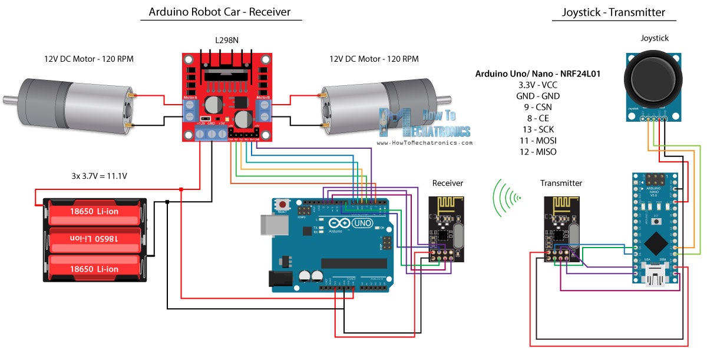
CIRCUIT DIAGRAM

Slide 6
WORKING
When robot is powered on.
Transmitter consist of joystick and buttons which gives the signal to Arduino and it transmit the data using nRF module.
The radio frequency module placed on bot i.e. receiver detect the code sending by transmitter. And acts according to it.
By using joystick, speed of bot can be controlled.

Slide 7
APPLICATIONS
This can be used for surveillance system.
Military usage of remotely controlled military vehicles.
UGVs have multiple uses from transferring goods in various places like industries or warehouses.

Slide 8
THANK YOU

